Slide 1
VCSEL – Positioning
Kevin Jose ACUNA CONDORI
01/10/2026

Slide 2
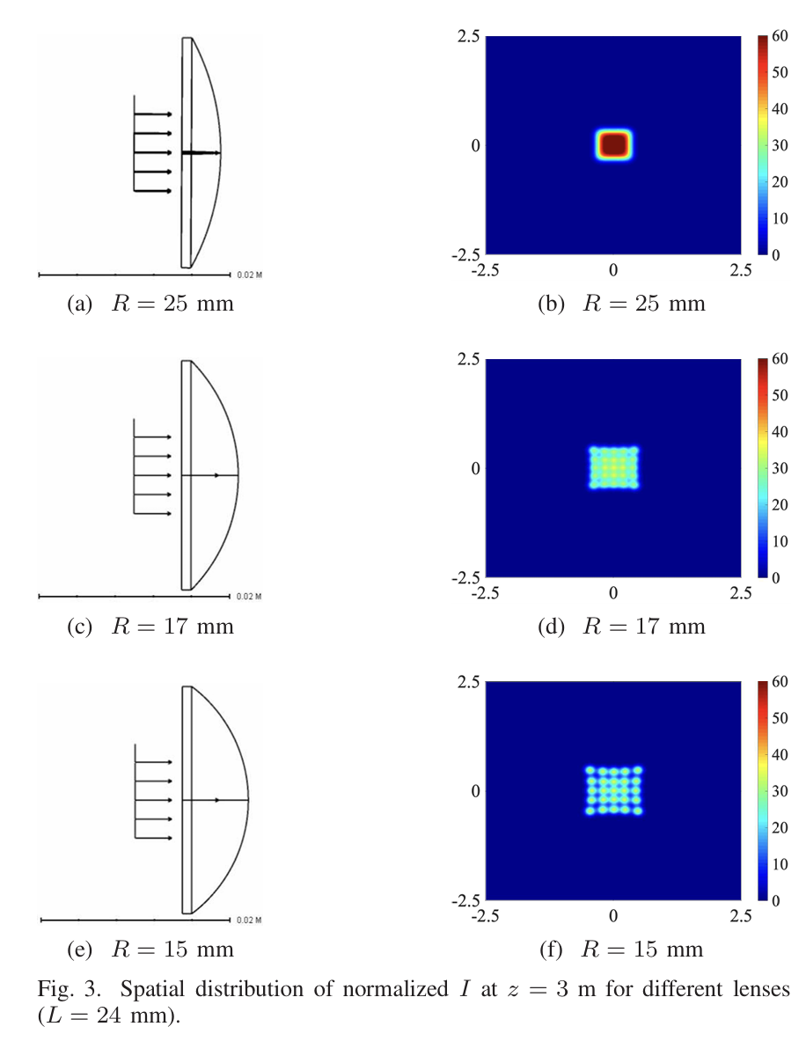
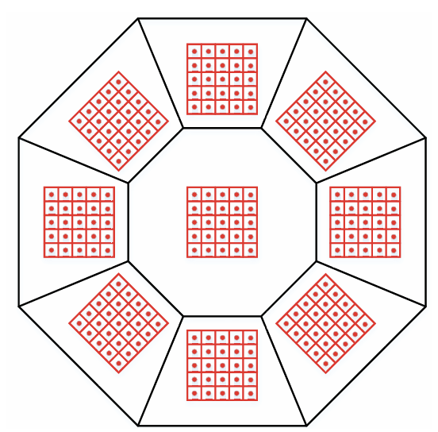
INTRODUCTION
2020, E. Sarbazi et al.
(Concept)

Slide 3
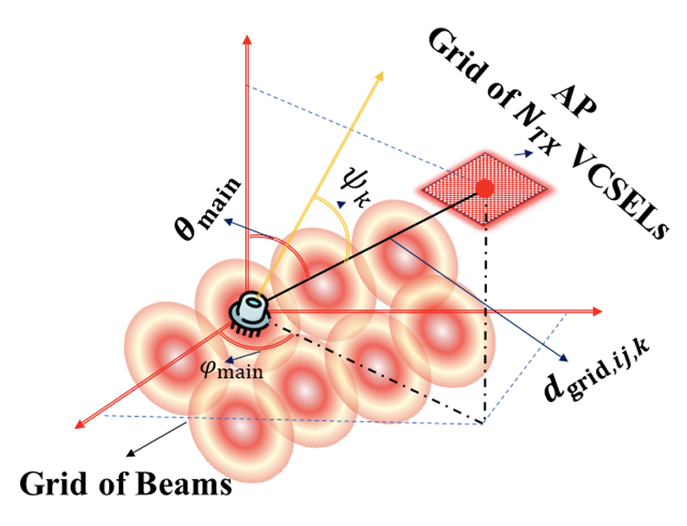
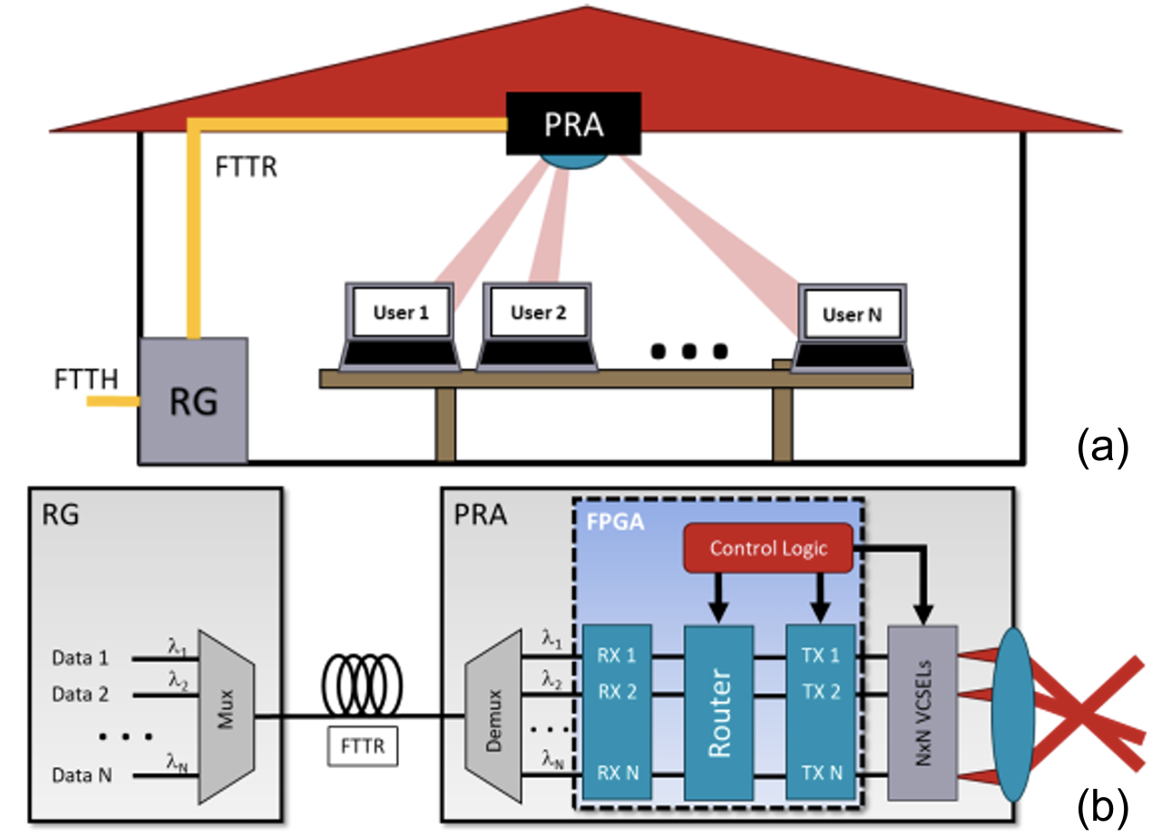
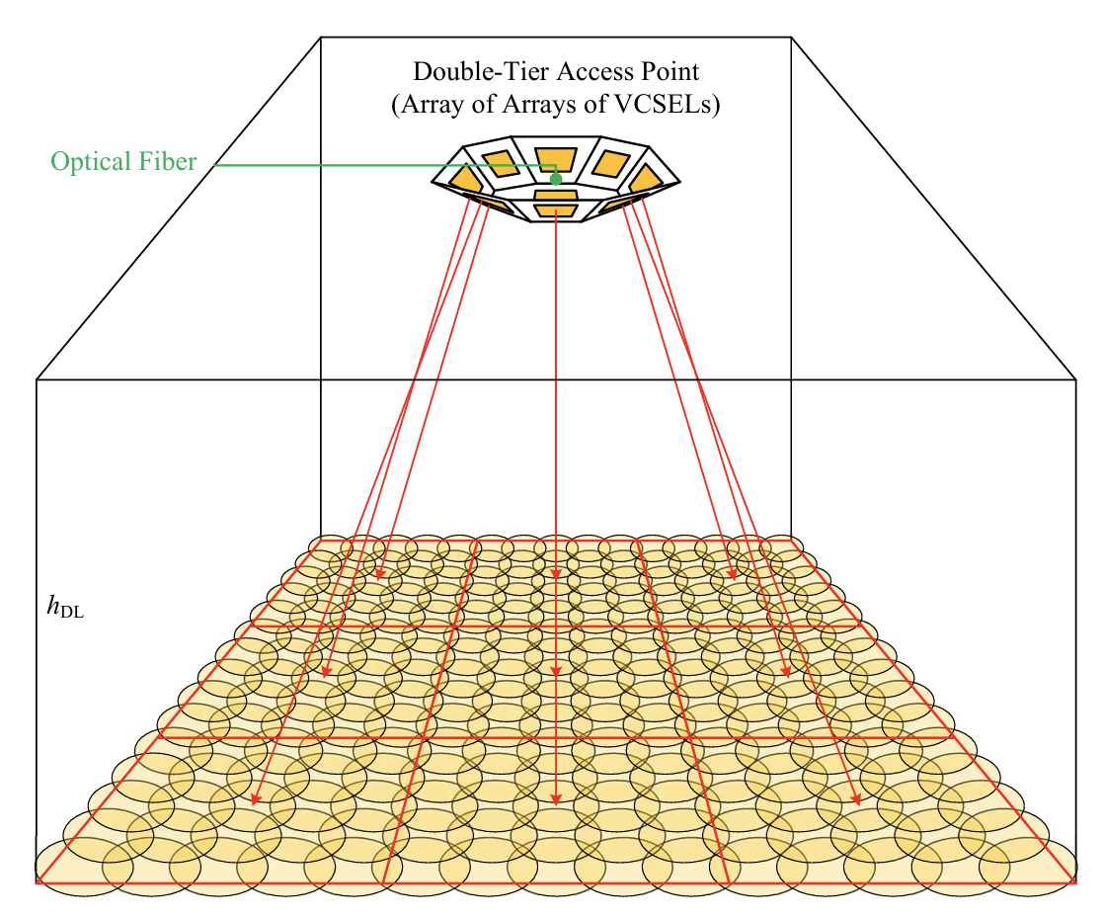
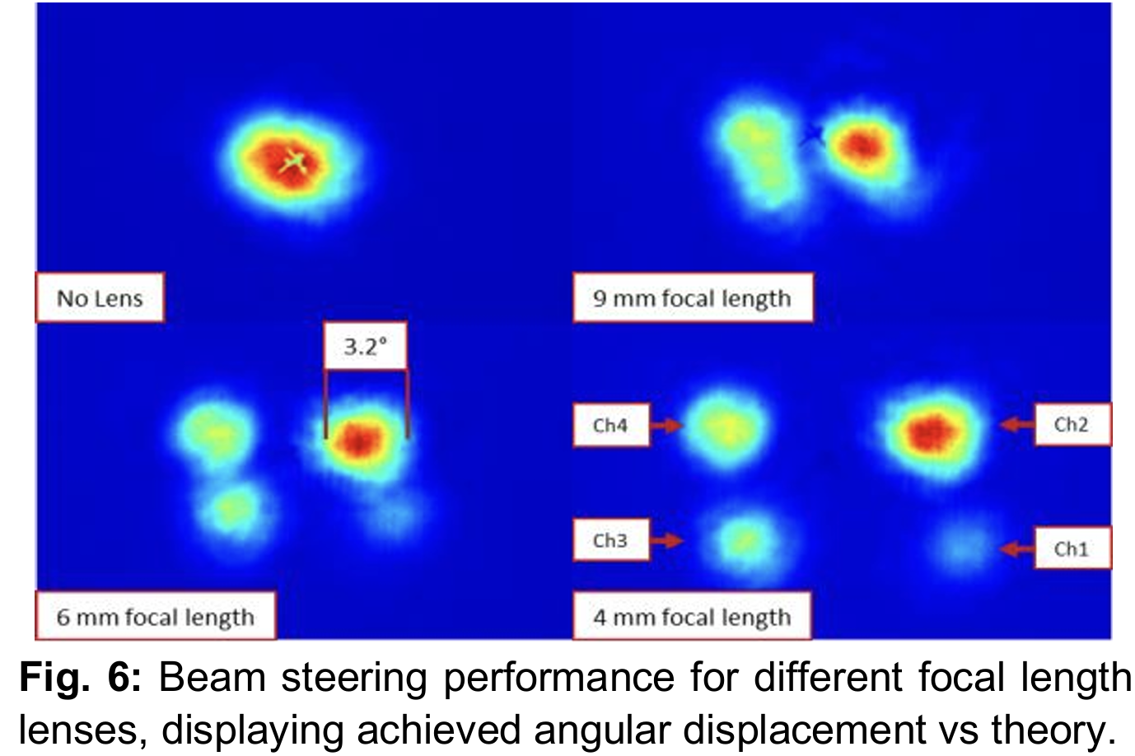
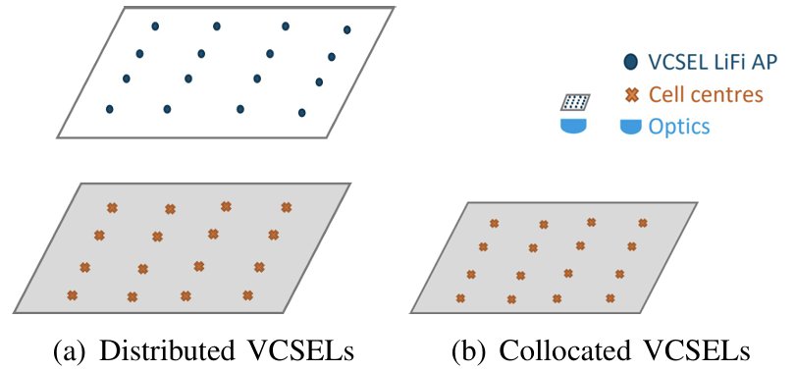
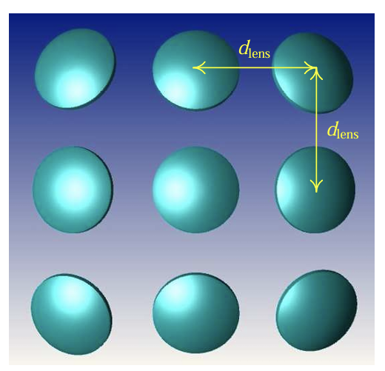
INTRODUCTION
2026, H. Safie et al.
(Communication)
2025, E. Muller et al.
(2x2 VCSEL - Beam-Steering)
2025, H. Kazemi et al.
(Communication)
2023, R. Ahmad et al.
(Positioning)

Slide 4
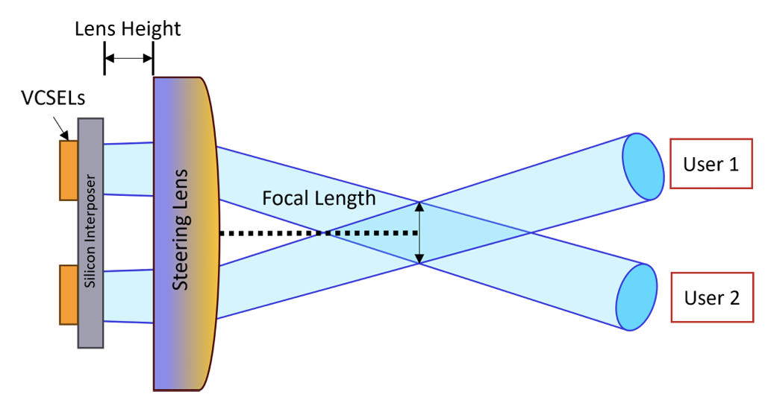
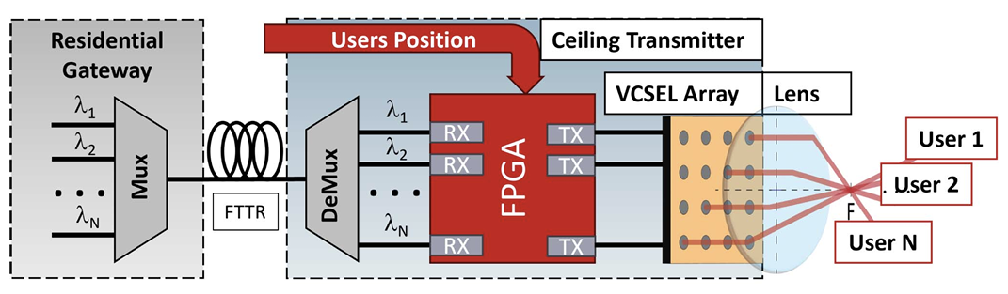
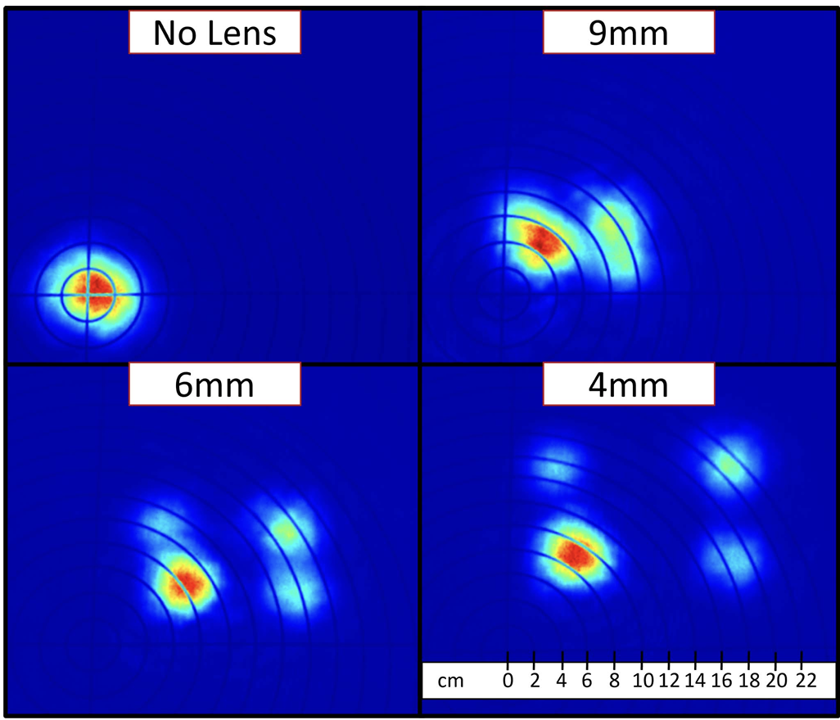
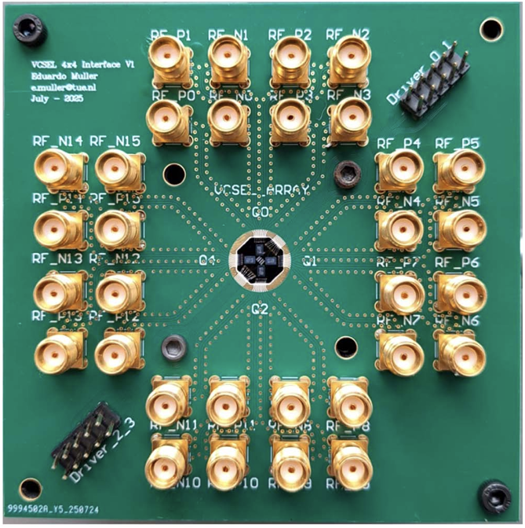
INTRODUCTION
2026, E. Muller et al.
(4x4 VCSEL, Beam-Steering)

Slide 5
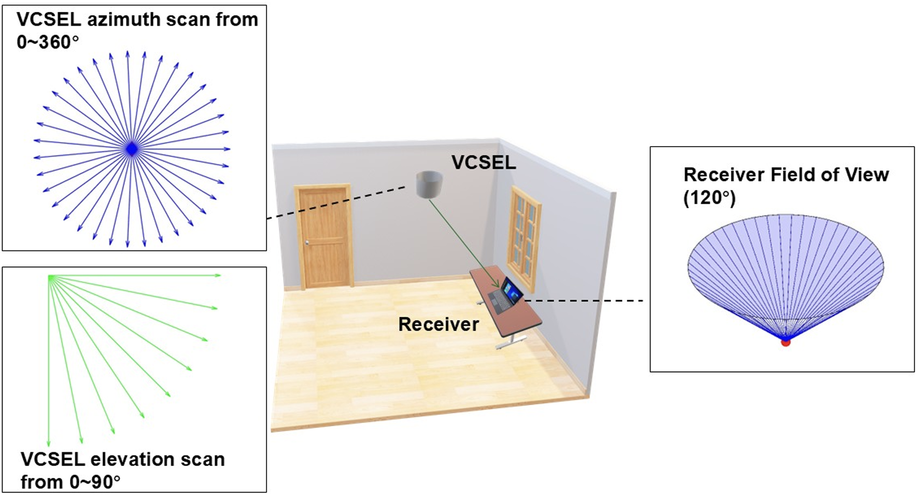
INTRODUCTION
2026, Y. Dong et al.
(Positioning)

Slide 6
